Slide 1

DEPARTMENT OF COMPUTER SCIENCE AND ENGINEERING (AI&ML)
AI POWERED VEHICLE DAMAGE ASSESSMENT AND COST ESTIMATION FOR INSURANCE CLAIMS
Under the Guidance of
Asst Prof.J.VEDIKA
Presented by:
U.SWATHI (206Y1A6649)
D.SUSMITHA (216Y5A6601)
N.BHARANI (206Y1A6636)
B.BHAVANI (206Y1A6606)

Slide 2
ABSTRACT
Nowadays, a lot of money is being wasted in the car insurance business due to leakage claims. Claims leakage /Underwriting leakage is characterized as the discrepancy between the actual payment of claims made and the sum that should have been paid if all of the industry's leading practices were applied. Visual examination and testing have been used to may these results. However, they impose delays in the processing of claims.
To address these challenges, AI powered solutions have emerged to enhance the accuracy and efficiency of vehicle damage assessment and cost estimation for insurance claims.
The aim of this project is to build a VGG16(CNN) model to analyze the images of damaged vehicles, computer vision model that can detect the area of damage on a car and estimate the cost for insurance claims.

Slide 3
INTRODUCTION
Processing claims for identifying and classifying automotive damages is time consuming as well as costly for insurance providers. Furthermore, poor decision-making, fraud, and processing cost insurance firms millions of dollars. As a result, they are the first to invest in AI (Artificial Intelligence), increased automation, and other technologies.
Car insurance companies spend millions of dollars each year due to escaping of insurance claims in today's society where the number of car accidents is on the rise.
In the insurance industry, Artificial intelligence (AI) based on machine learning and deep learning can assist with challenges including data analysis and processing, fraud detection, risk reduction, and claim automation. As a result, insurance companies have sought to reduce the time it takes to analyze damage and settle claims.

Slide 4
PROBLEM STATEMENT
The car insurance industry faces significant financial losses due to claims leakage, arising from difference between actual and expected claim payments. Traditional methods of visual examination and testing for vehicle damage assessment and cost estimation are time-consuming, error-prone, and contribute to delays in claims processing. To overcome these challenges, there is a critical need for a streamlined, efficient, and accurate solution leveraging the power of artificial intelligence (AI) in the form of computer vision and machine learning.

Slide 5
EXISTING SYSTEM
The current system for assessing vehicle damage and estimating insurance claim costs relies heavily on manual processes, which are slow, subjective, and prone to errors. This method involves a lot of paperwork, causing delays in settling claims.
Existing systems have used complex multiple techniques like machine learning, including convolutional neural networks (CNNs), for automatic damage detection in vehicle images. Natural language processing (NLP) algorithms help analyze text in claims documents, extracting key details to estimate costs.
Predictive analytics using historical claims data aids in fraud prevention, streamlining the vehicle damage assessment process and providing accurate cost estimates for insurers and policyholders.

Slide 6
PROPOSED SYSTEM
AI-powered system capable of detecting and assessing damaged areas on cars, using a VGG16 model based on convolutional neural network (CNN)to autonomously detect car damage in images to enable insurance companies to expedite claims processing by allowing users to upload images for automated damage assessment and cost estimation.

Slide 7
SOFTWARE REQUIREMENTS
Google Colab, VS CODE – Python(3)
Libraries used:
Numpy, Pandas, Scikit learn, Keras
HARDWARE REQUIREMENTS
Operating System –Microsoft Windows 7/8/10 (32 or 64 bit) with (min) i5, i7 Processor.
RAM – 4GB(min),8 GB recommended memory.
Disk space: Internal Storage – 8GB(min)

Slide 8
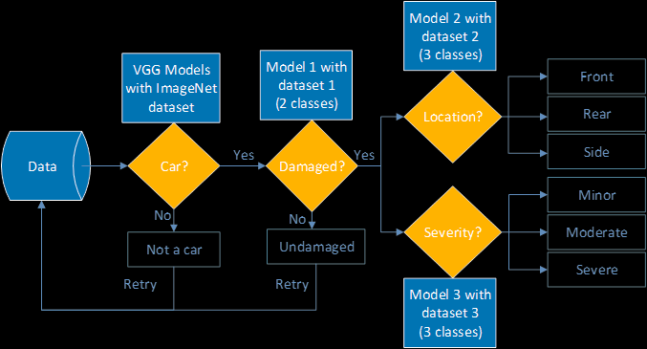
ARCHITECTURE

Slide 9
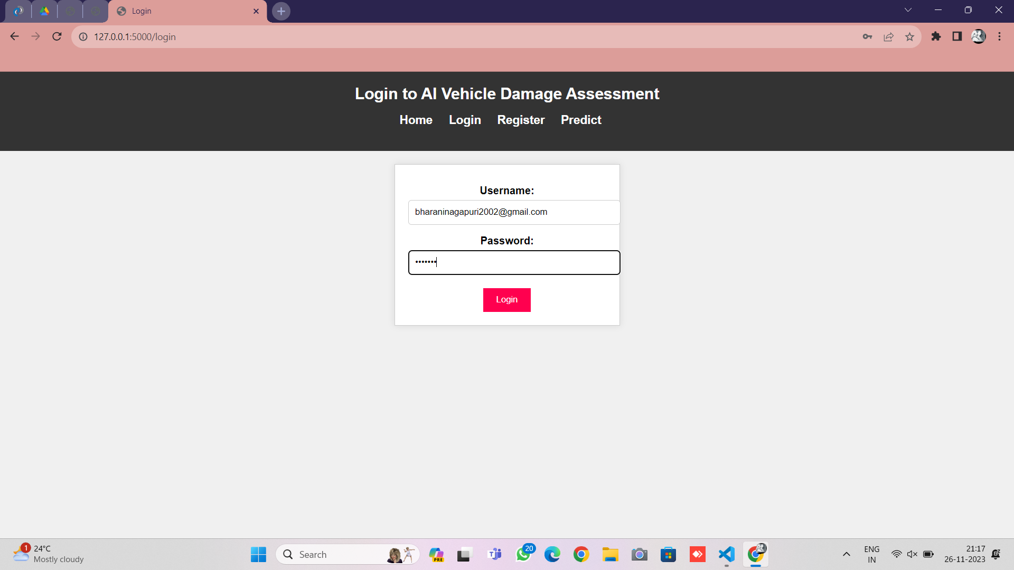
IMPLEMENTATION RESULTS AND TEST CASES

Slide 10
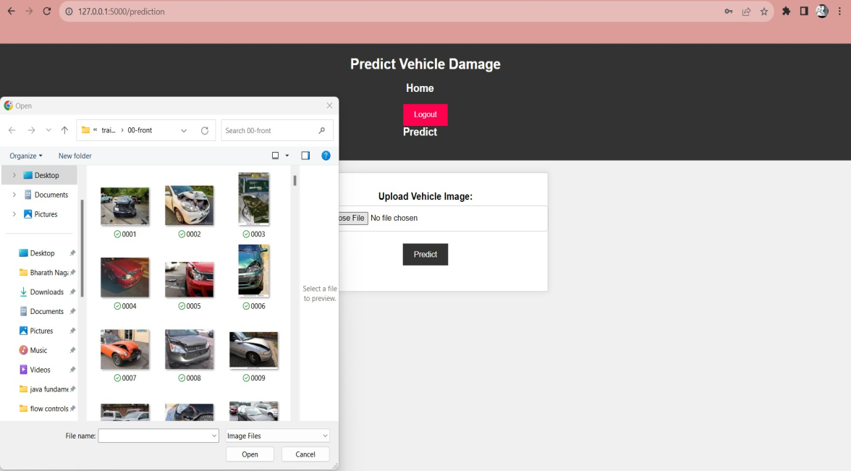
IMPLEMENTATION RESULTS AND TEST CASES

Slide 11
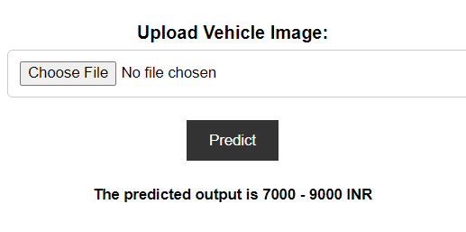
IMPLEMENTATION RESULTS AND TEST CASES

Slide 12
CONCLUSION
In conclusion, this project "AI-Powered Vehicle Damage Assessment and Cost Estimation for Insurance Claims" offers a transformative solution to the challenges faced by the insurance and automotive industries.
The system's ability to provide fair and data_x0002_driven cost estimations not only benefits policyholders but also contributes to fraud detection and risk assessment for insurance companies.

Slide 13


